Slide 1

NI
LECTURE
Windows 2016:
Group Policy Management
Networking Infrastructure
Diploma in CSF/IT
Year 2 (2022/23), Semester 3
16

Slide 2
Objectives
At the end of this, you will understand the following:
What is a group policy?
What is the benefit of using group policy?
What are the uses of group policy?
How and where to apply and deploy group policy?
How to implement group policy?
When does group policy get applied?

Slide 3
What is a group policy?
Allows administrators to manage and apply configuration settings centrally.
A centralised collection of computer and user configuration settings that can be applied to multiple computers and users.
Define what a system will look like and how it will behave for a defined group of computers/users.
Modifies the computer-specific and user-specific registry settings.
Available in Active Directory domains.
Notes:
Group Policy settings and logon scripts are stored in the subfolders of the C:\Windows\SYSVOL folder.

Slide 4
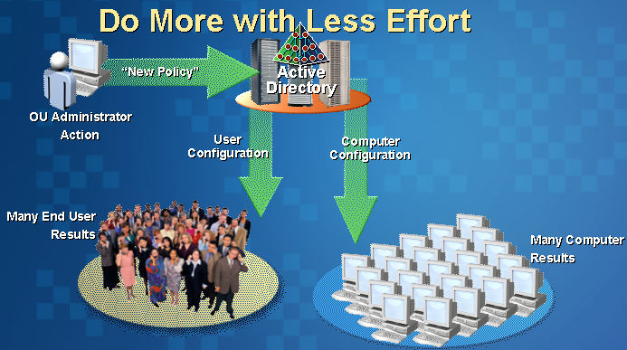
Benefit of Using Group Policy
Reduce administrative effort of IT staff.
Administrators configure settings once, and then the group policy settings apply continuously to users and/or computers.
A good policy will give greater productivity for users and reduce the time spent solving problems.
Better to set a policy to customize the users’ desktop than for users to fiddle with their control panel.

Slide 5
A group policy can (1):
A group policy can:
Control user desktop settings
e.g. which icons appear on desktop
Restrict certain types of programs or executables to run
e.g. which programs are available from Start Menu
Control security settings on computers
e.g. password policy, account lockout policy
Install applications on clients automatically (i.e. software Deployment: push applications to computers/users)
Control settings which dictate operating system behaviour
e.g. Disable unnecessary services such as telnet or IIS.
Notes:
Lab session on Group Policy
1. Group Policy for Showroom OU (apply all showroom users):
Hide and disable all items on the Desktop
No Run and Logoff from Start Menu
2. Domain Policy for User Account (Computer configuration)
Password policy
Account Lockout policy
3. Domain Policy for Software deployment (User configuration)

Slide 6
A group policy can (2):
A group policy can also:
Run scripts for users during logon, logoff, startup and shutdown.
Control the configuration of both the user and the computer settings.
e.g. if you need to change everyone's proxy server, then add the IP addresses to a Group Policy rather than edit every Internet Explorer in each client manually.
etc …

Slide 7
Group Policy Terms
Local Group Policy | Refers to the policy that configures the local computer or server and is not inherited from the domain.
Group Policy Object (GPO) | Refers to the policy that is configured at the Active Directory level. GPOs are “Virtual objects” in AD. Can configure GPO at site level, domain level, or OU level.
Group Policy Container (GPC) | Storing of the GPOs. Any GPO that is created will not be effective until it is linked to an OU, domain or a site. GPOs are replicated among domain controllers of the domain through replication of the Active Directory
Notes:
For NI module, focus on GPO at domain level and OU level.
Policy is applied with the order: local group policy, site, domain, OU (OU is evaluated last and has the highest precedence)

Slide 8
Windows 2016 Group Policy
Each GPO has two distinct areas of configuration:
Computer Configuration
Use “Computer configuration” to set policies that will be applied to computer (prior to user logon), regardless of who logs on to the computers.
User Configuration
Use “User Configuration” to set policies that will be applied to users after user logon, regardless of which computer they log on to.
Notes:
Note: Computer config overrides User config.
Lab session on Group Policy
1. Group Policy for Showroom OU (OU Level – User Configuration):
Hide and disable all items on the Desktop
No Run and Logoff from Start Menu
2. Domain Policy for User Account (Domain Level - Computer Configuration)
Password policy
Account Lockout policy
3. Domain Policy for Software deployment (Domain Level - User configuration)

Slide 9
Windows 2016 Group Policy
Computer/User Configuration has 3 areas of settings:
Software Settings
Allows for deployment of software to specific user/computer (updates and installations)
Windows Settings
Scripts : Startup, Shutdown, Logon & Log off scripts.
Security Settings: Account Policies, User Rights, Software Restriction Policies
Administrative Templates
Local registry settings that affect the desktop appearance, application settings and behaviour of certain systems events and services
Notes:
Lab session on Group Policy
Administrative templates: e.g. Desktop, Start Menu
Windows settings: e.g. security settings for user accounts
Software settings: e.g. installation/deployment of software

Slide 10
Software Settings - Software Deployment
Software Deployment
Allows for remote management of applications
(install, update, uninstall)
Steps to deploying software
Acquire Windows Installer (MSI) package (*.msi)
Place package on shared folder and set the correct permissions
Select OU/Domain - create and link GPO
Configure GPO for software deployment

Slide 11
Software Settings - Software Deployment
3 Deployment Options:
Assign to user : Application available to user for installation.
Application shortcut available to user on Start Menu. Application only installs when user access the shortcut or open it with associated document.
Assign to computer: Installed automatically during boot up. Makes software available to all users of the machine.
Publish: available only for users. User choose to install from add/remove programs.

Slide 12
Windows Settings (1)
Example:
Security Settings -> Account Policies -> Password Policy
Password length (0-14) – at least 8 chars
Password History (1 - 24 entries) – at least 3 times
Cannot re-use most recent password
Password age (0-999) – at least 24 hours
Passwords must meet complexity requirements (contain 3 to 4 character classes: Uppercase, Lowercase, Number and Special Characters)
Store passwords using reversible encryption for all users in the domain.

Slide 13
Windows Settings (2)
Example:
Security Settings -> Account Policies -> Accounts Lockout Policy
Check for failed logon attempts, and lock the account for a certain amount of time
Lockout threshold: 3 invalid failed logon attempts
Lockout duration (0 – 99999 minutes) (15 minutes)
Unlock Account: 15 minutes. Counter reset after time limit

Slide 14
Administrative Templates
Lockdown Policy (e.g. guest/kiosk terminals)
Desktops
Hide all icons on desktop;
Disable/Remove Shutdown command
Do not save settings on exit
Remove run menu
Disable Task Manager
Hide common program groups in Start menu
Network Access Lockdown
Hide My Network Places
Remove “Map Network Drive”

Slide 15
Implementing Group Policy
Steps in implementing group policies:
Select an Object (OU, Domain objects) and Create a group policy object (GPO) and link it to the selected object.
GPO is an active directory object (just like an user account object)
Can be configured by any user in the Active Directory
Configure GPO Settings.
Notes:
Lab session on Group Policy
Right click on Showroom OU and select “Create a GPO in this domain and link it here”.

Slide 16
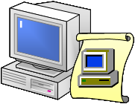

When Does Group Policy Get Applied? (1)
Windows 2016:
Applies computer settings from group policies
Computer starts
Windows 2016:
Applies user settings from group policies
User logs on
User logoff (user configuration): Logoff scripts only
Computer shutdown (computer configuration): Shutdown scripts only

Slide 17
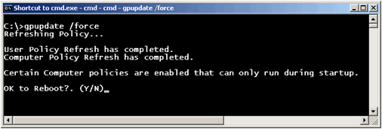
When Does Group Policy Get Applied? (2)
GPOs on AD is refreshed on the computers by several ways:
Every 60 to 90 minutes, the computers query their DC for updates.
Domain controllers: 5 minutes
Manually by using gpupdate /force command.
Exceptions
Folder redirection - user logon
Logon/logoff scripts
Startup/shutdown scripts
Software deployment - user logon/computer startup

Slide 18
Best Practices
Use Default Domain Policy solely for Domain Account Policy settings, remember all settings in this policy are applied to all Users and Computers in the domain so you should limit the amount settings made in this GPO.
Use OUs to group computer objects that will share the same configuration, (i.e. separate Clients from Servers)
Use OUs to group user objects that will share the same configuration (i.e. separate Admins from Standard Users).
Group similar users. Place similar users/groups in separate containers (i.e. OUs).
When creating new GPOs, disable until finished.

Slide 19
Summary
Group Policy is a mechanism that stores a collection of computers and user configuration settings that can be applied to multiple users and computers.
Group Policy can be used in many situations:
Deploying Software/Updates
Desktop Control
Password and Audit Policy
Group policy objects can be applied to different levels of containers/ objects :
Active Directory Sites
Active Directory Domains
Organizational Units (OUs)

